Slide 1
Time Series Analysis and Forecasting using Python
PyData Patna Conference
Speaker:
Vatsal Singhal
Dept of Computer Science and Engg. IIT Patna

Slide 2
What is Time Series?
A set of observations on the values that a variable takes at different times.
It is a value of some variable(s) that is observed at fixed time inveratals.
The frequency of data can vary.
It can be hourly, daily, weekly, monthly or annually.

Slide 3
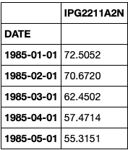
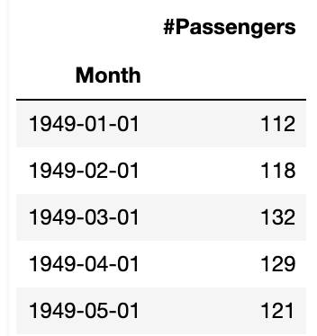
Some Examples of time series:
Daily record of number of passenger using Delhi Metro.
Data of temperature recorded every hour.
Monthly sales data for a product.
Annual revenues generated by a company.
Daily stock price of a particular stock
Monthly Electricity Production
Monthly Air Travellers

Slide 4
Time Series Forecasting
The process of predicting the future values of a time series using the past available data.
Various different models can be employed for time series forecasting. Eg. Autoregression, ARMA, ARIMA, LSTM, etc.
Important in many fields like finance, business, applied sciences, etc.

Slide 5
Some popular use cases:
Predicting future sales of a product.
Projecting future revenues, profits, expenses, etc of a firm
Predicting future prices of a stock.
Predicting the temperature or amount of rainfall for a future time.

Slide 6
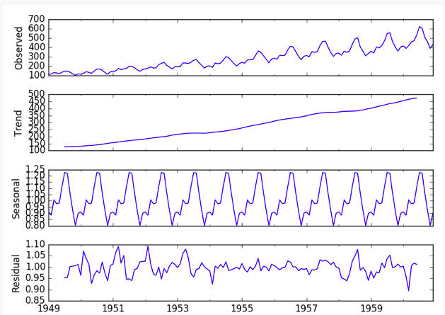
Structure of time series
Consists of 4 major component:
Trend(T)
Seasonal (S)
Cyclic (C)
Residual (R)
Decomposition can be additive or multiplicative.
Time Series = T + S + C + R
Time Series = T * S * C * R
SRC: https://machinelearningmastery.com/decompose-time-series-data-trend-seasonality/

Slide 7
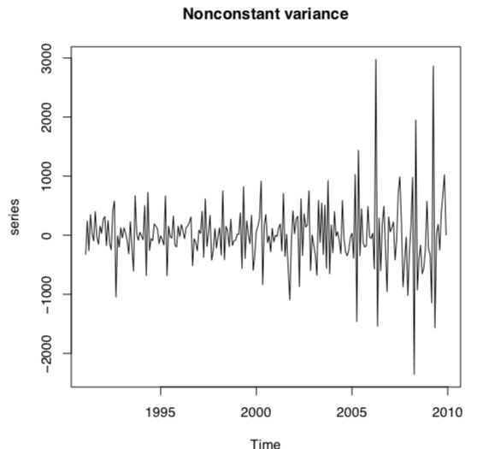
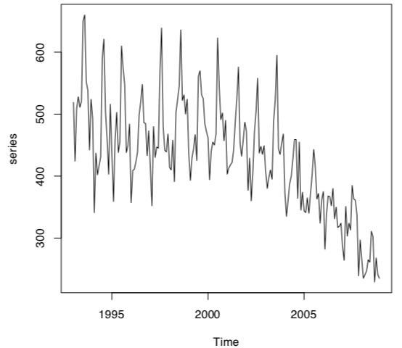
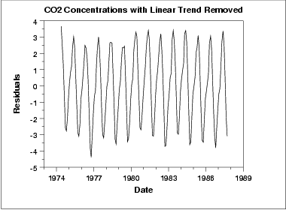
Stationarity of time series
Non Constant Variance
Conditions of stationarity:
Constant mean for all time steps.
Constant variance for all time steps.
The autocovariance function between X_{t1} and X_{t2} only depends on the interval t1 and t2.
Tests for Stationarity:
Augmented Dickey-Fuller test
KPSS test
Non Constant Mean
SRC: R Cran Package TS Tutorial
Stationary Time Series

Slide 8
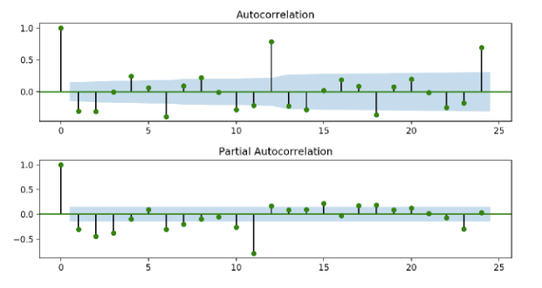
ACF and PACF
Autocorrelation Function:
The correlation of a variable with lagged value of itself.
When a variable is linearly dependent on its own past value.
Partial Autocorrelation Function:
The correlation of a variable with lagged value of itself taking into consideration the relationships of these terms with other lagged values.
Src: https://arauto.readthedocs.io/en/latest/how_to_choose_terms.html

Slide 9
Hands on Sessions
ARIMA and SARIMA model
Prophet Model
Deep Learning Models like LSTM and N-BEATS

Slide 10
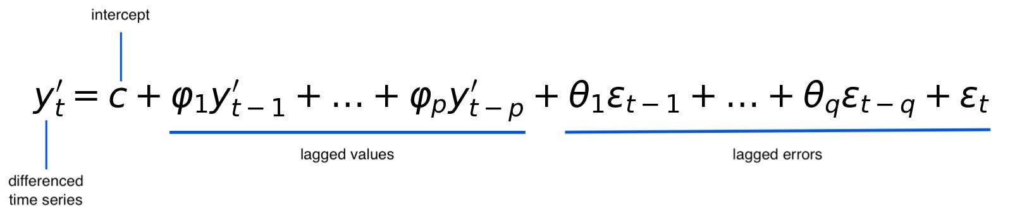
ARIMA and SARIMA Models
ARIMA(p,d,q) Model:
SARIMA(p,d,q)(P,D,Q) Model:
If we can identify a seasonal component in time series then we can use SARIMA.
P, D, Q are analogous to p, d, q but are terms used for the seasonal component.
Complex Mathematical equation.

Slide 11
How to choose parameters?
One way is to use ACF and PACF.
Other is we can use a grid search and try to minimize AIC and BIC.
Akaike information criterion = 2K - 2(LL)
Log-likelihood = log(RSS/N)
K = number of model parameters.
Bayes information criterion = -2 * LL + log(N) * K
Log-likelihood = log(RSS/n)
K = number of model parameters.
N = Number of training examples

Slide 12
Demo of ARIMA and SARIMA
Link: bit.ly/pydata-patna-arima

Slide 13
fbprophet Models
Developed by Facebook.
Very fast and easy to use.
An additive regression model where non-linear trends are fit with yearly, weekly, and daily seasonality, plus holiday effects.
Eq: y(t) = g(t) + s(t) + h(t) + ε_{t}
g(t): piecewise linear or logistic growth curve for trend
s(t): periodic changes
h(t): effects of holidays
ε_{t}: Residual term

Slide 14
Demo of Prophet Model
Link: bit.ly/pydata-patna-prophet

Slide 15
Deep Learning Models
When a time series has complex non-linear relations.
Neural Networks can map complex relations with ease.
NN are good at pattern recognition and can map deep relationships like human brain.
Commonly used deep learning architectures in time series:
RNN
GRU
CNN
LSTM
N-BEATS

Slide 16
Demo of Deep Learning
Link: bit.ly/pydata-patna-dl

Slide 17
Recap
What is time series?
What is time series forecasting?
Why time series forecasting is needed.
Basic concepts of time series like ACF, PACF, Stationarity, Seasonality, etc.
Some widely used time series models like:
ARIMA and SARIMA
Prophet Model
LSTM and N-BEATS

Slide 18
Thank You
Link to code: bit.ly/pydata-patna-ts
Github: github.com/vatsalsin
Linkedin: linkedin.com/in/vatsalsin

